Slide 1

Multi Task Learning on Face Images with a Task Constrained Deep Convolutional Neural Network
Emanuele Alessi
Gianmarco Forcella
July 8, 2019

Slide 2
Multi Task Learning
In Computer Vision tasks, it is often asked to have a Neural Network that is capable of learning and predicting more things at once. While sometimes this resolves in having more than one Network for every single task, this became inefficient in a very short time.
In the early 2000s, though, researchers finally proposed a “way out” to this problem. If we humans can be multitasking, so can computers and, so, can neural networks.
Today’s presentation will focus on a implementation proposal of a TCDCN
Multi Task Learning on Face Images with a Task Constrained Deep Convolutional Neural Network
Using Social Media to Enhance Emergency Situation Awareness

Slide 3


Reference
We have based our approach on the paper Xxx and XXXin which they tried to resolve this kind of problem implementing this system architecture.
We focused on the prediction of six cases
They’ve used a Task Constrained Neural Network
We replicate their method, adding a more recent Neural Network approach (due to papers’s age)
Using SocialMedia to Enhance Emergency Situation Awareness
Multi Task Learning on Face Images with a Task Constrained Deep Convolutional Neural Network

Slide 4
Our proposal
We decised to propose a model that is based on:
L2 Regularization
Batch Normalization
Using SocialMedia to Enhance Emergency Situation Awareness
Multi Task Learning on Face Images with a Task Constrained Deep Convolutional Neural Network

Slide 5
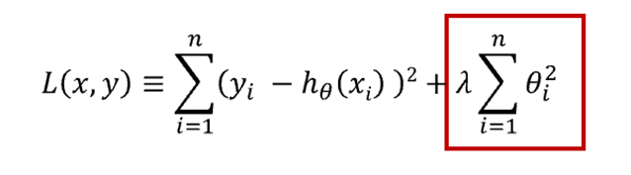
L2 Regularization
it allows to apply penalties on layer parameters during optimization
These penalties are incorporated in the loss function that the network optimizes
Using SocialMedia to Enhance Emergency Situation Awareness
Multi Task Learning on Face Images with a Task Constrained Deep Convolutional Neural Network

Slide 6
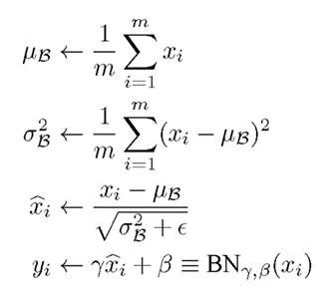
Batch Normalization
It normalizes the activation of the previous layer at each
It also acts as a regularizer, in some cases eliminating the need for Dropout
Using SocialMedia to Enhance Emergency Situation Awareness
Multi Task Learning on Face Images with a Task Constrained Deep Convolutional Neural Network

Slide 7
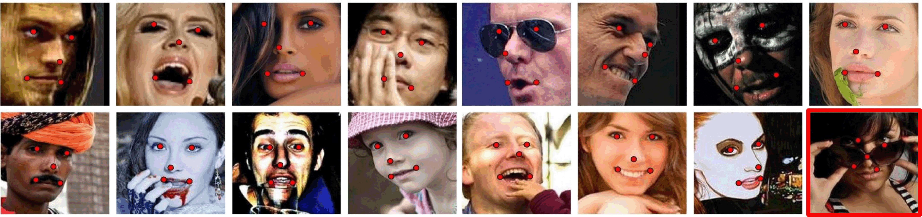
MAFL dataset
We used MAFL (Multi Attribute Facial Landmarks), which is a subset of CelebA
It is annotated with 5 facial landmarks and 40 different facial attributes
19000 images for training
1000 images for testing
Using SocialMedia to Enhance Emergency Situation Awareness
Multi Task Learning on Face Images with a Task Constrained Deep Convolutional Neural Network

Slide 8

Tensorflow
An open source machine learning
Developed by Google
The most used nowadays
It guarantees a very efficient computation
Multi Task Learning on Face Images with a Task Constrained Deep Convolutional Neural Network

Slide 9
Our TCDCN
Using SocialMedia to Enhance Emergency Situation Awareness
Multi Task Learning on Face Images with a Task Constrained Deep Convolutional Neural Network

Slide 10
Convolutionsl NN
INSERIRE DISEGNO RETE

Slide 11
LOSS
Vogliamo proporre la funzione di loss qui?

Slide 12
INSERIRE SLIDE TF ​
TCDCN
Using Social Media to Enhance Emergency Situation Awareness

Slide 13
TRAINING DELLA RETE

Slide 14
Dataset
As for the dataset, we used MAFL, which is a subset of celebA.
This dataset consist in 20000 face pictures of various persons that also holds some details about them (ie, landmarks position, whether the subject has facial hair or not, and so on…)
TCDCN
Using Social Media to Enhance Emergency Situation Awareness

Slide 15
Loading in memory
The images are loaded in the main memory in pairs of 32 at a time, so that we can ensure a better performance.
They are loaded to the main memory thanks to Python’s PIL Library. After this process, everytime, they are subject to a data augmentation process (height and width shift), and then shrinked to a 48x48x1 (only one channel because they are loaded as a gray-scale) numpy array

